Slide 1


Slide 2


Slide 3
What our System
Stand foR

Slide 4
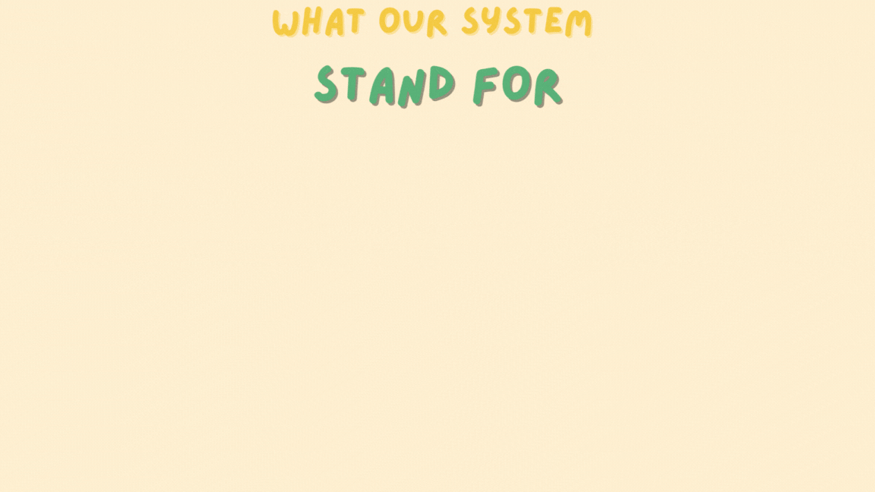

Slide 5


What our System
Stand foR
add a food item
Delete a food item

Slide 6
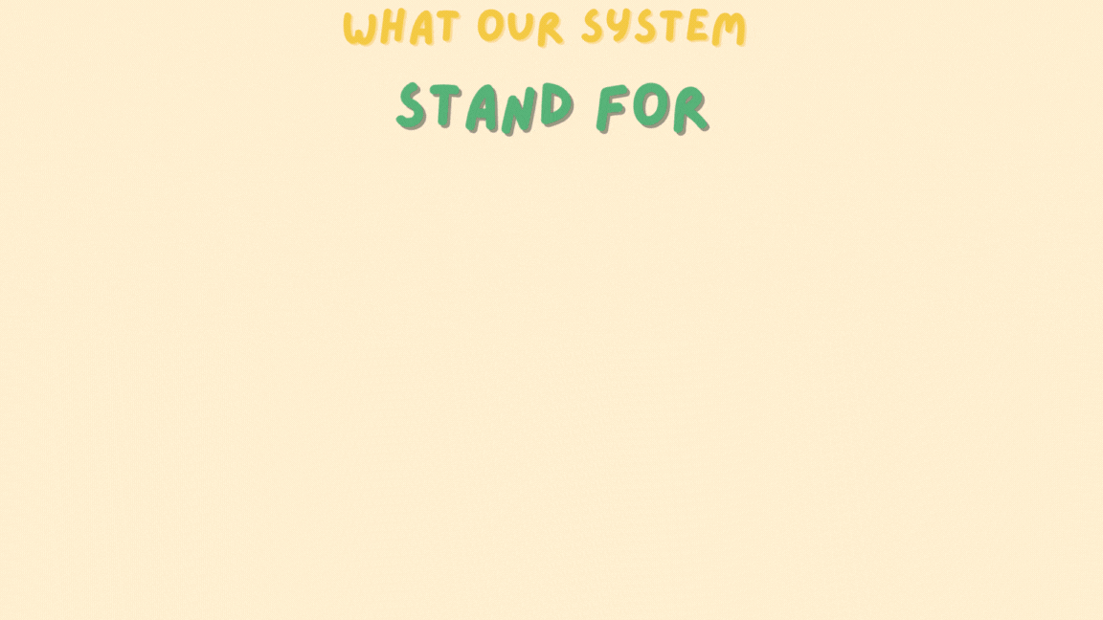

Slide 7
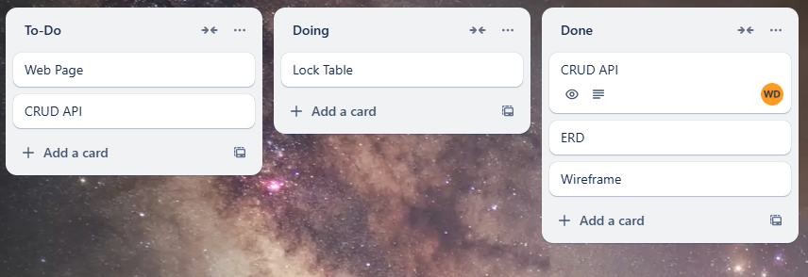
Trello

Slide 8
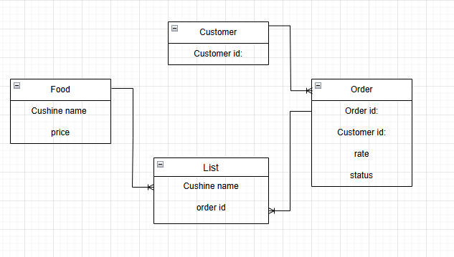
Entity Relationship Diagram (ERD)

Slide 9
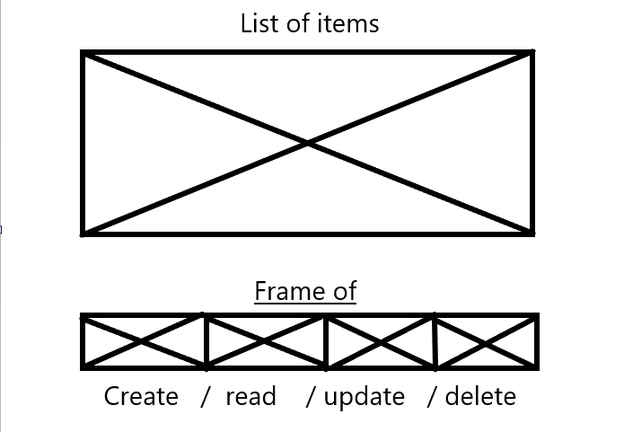
wireframe

Slide 10
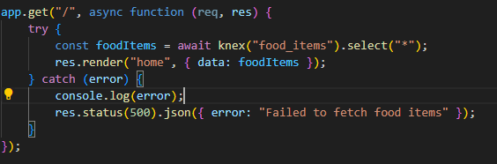
The Get API Functions

Slide 11
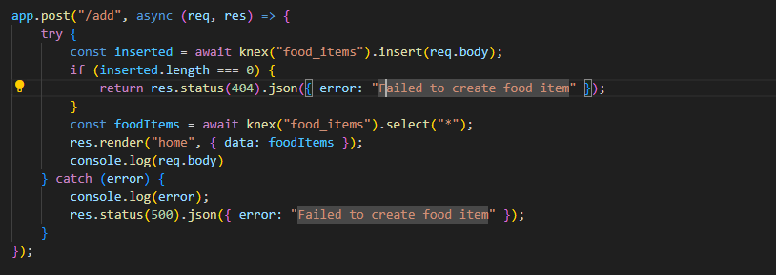
The add API Functions

Slide 12
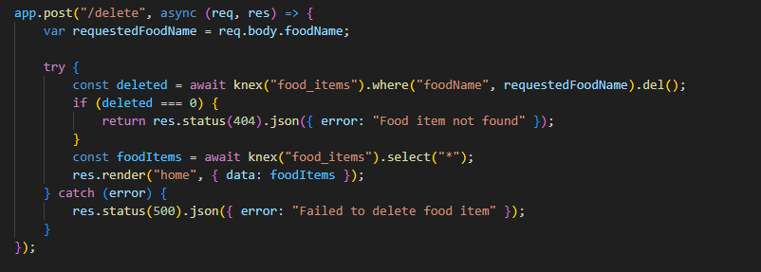
The delete API Functions

Slide 13
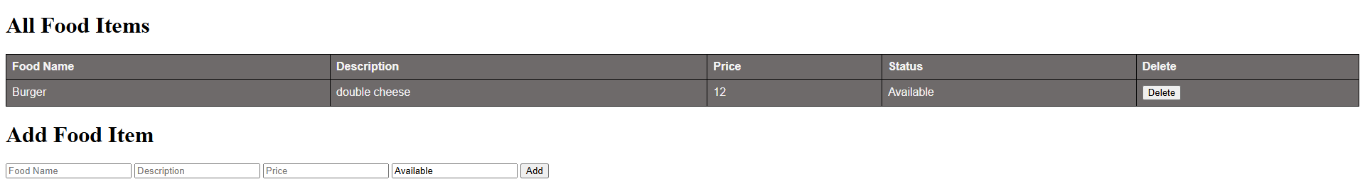
Outcome

